Slide 1

Introduction To Machine Learning
Cisco - Batch 1

Slide 2
About Me:
Lavi Nigam
Data Scientist @ Gartner
Part-time Corporate Trainer
40 Under 40 Data Scientist India 2021
8+ Years in ML, DL & AI
Worked – Nokia, Boeing, HCL Research, Edelweiss
Trained - American Express, Intel, Tata Telecom, Juniper
Senior Faculty @ INSAID – Trained 4k+ Professional
LinkedIn - /lavinigam.
Email: lavinigam9@gmail.com
Class Github: https://github.com/equester/Cisco/tree/main/Batch1
Lab: https://cloud.cdp.rpsconsulting.in/console/

Slide 3
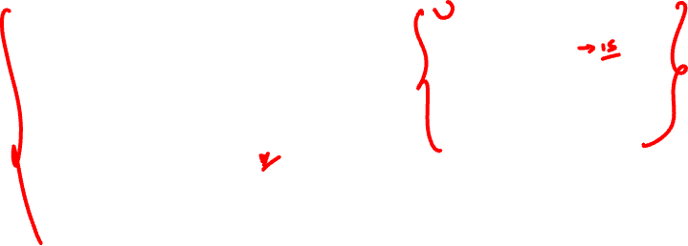
Agenda for Today
Day Plan
9.00 – 9.30 : Class Prep’s & Intro’s
9.30 – 10.30: Session
10.30 - 10.45: Break
10.45 – 12.30: Session
12.30 – 1.30: Lunch
1.30 – 3.00: Session
3.00 – 3.15: Break
3.15 – 5.00: Session
Netflix Data Science Case
Data & It’s Type
What is Data Science
Analytics, BI, EDA & ML
Data Scientist
Problems data science solves
Industry Applications
Data Science Cycle
What is Machine Learning
Traditional Programming vs ML
ML Terminologies
Types of Learning
Machine Learning Flow
Error Metrics
Model Interpretation

Slide 4



How many of you have seen this?

Slide 5



What about this?

Slide 6


Where have you seen these recommendations?
Netflix takes this a step further by personalizing recommendations

Slide 7
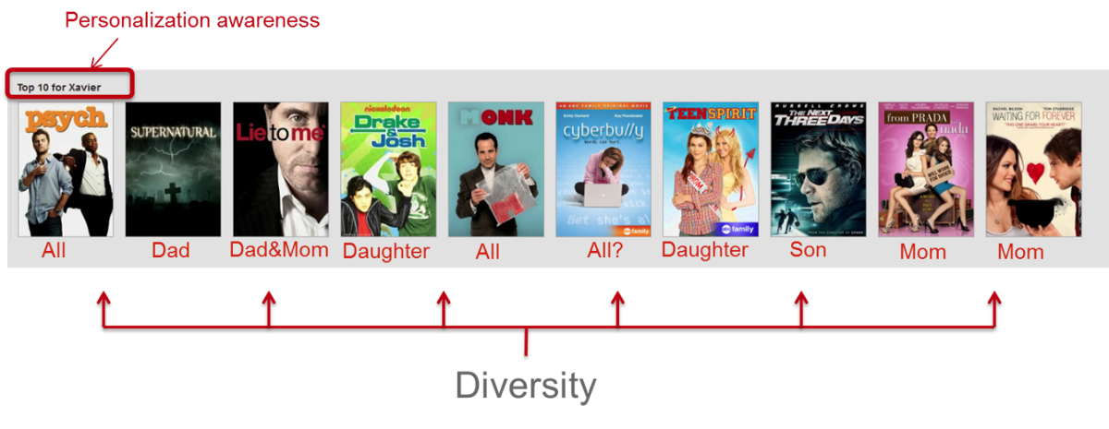
Personalization with diversity
Netflix has adapted personalization algorithms in such a way that now 75% of what people watch is from some sort of recommendation.
The Top 10 row of Netflix which is the best guess at the ten titles you are most likely to enjoy, the recommendations are not only meant for user but also everyone in user’s household.

Slide 8
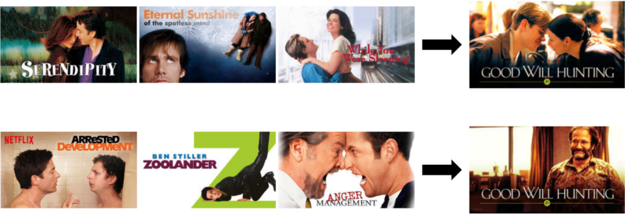
Personalization with different artwork
In Netflix the poster of a movie recommendation changes based on user’s tastes and preferences.
A user who likes genre “Romance” will most likely watch Good Will Hunting with the lead actors featuring in the poster whereas a user who likes genre “Comedy” will most likely watch Good Will Hunting if a well known comedy actor featured in the poster.

Slide 9
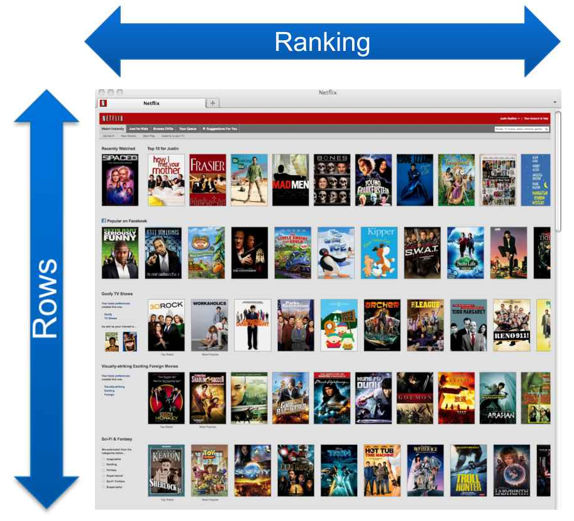
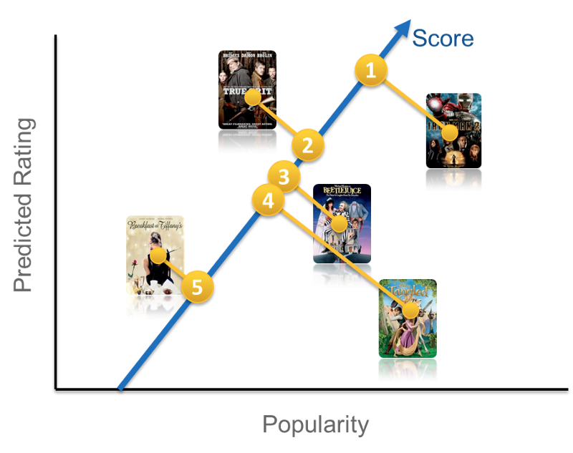

How does Netflix rank movies for viewers?
A simple scoring approach for the ranking function could be a linear combination of popularity and predicted rating
Notes:
let us start with

Slide 10
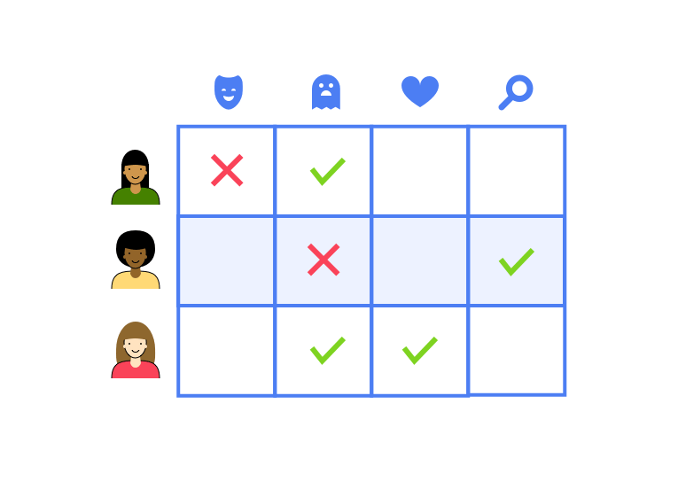
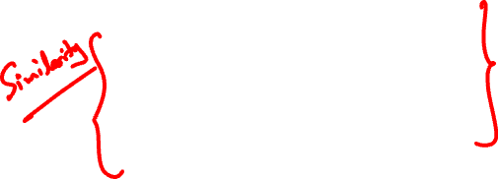
How does Netflix perform recommendations?
Usually recommendation engines, consists of a utility matrix, a probability model which places a score on the relationship between a user and a movie type in order to predict their preferences.
According to this matrix:
User 1 would be recommended with horror movies
User 2 would be recommended with more of light films with comedy and drama
User 3 would be recommended with more niche content like romantic thrillers.
Notes:
let us start with

Slide 11
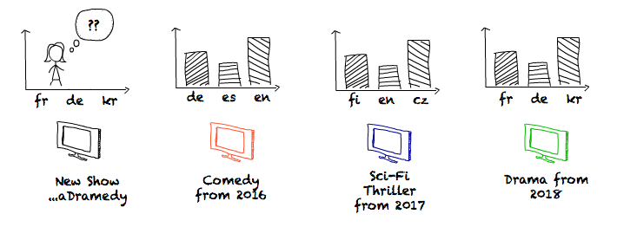
How does Netflix predict the consumption of a show globally?
Netflix predicts the per-language consumption for each show k months before it is released using historical viewing trends.
Notes:
https://medium.com/netflix-techblog/studio-production-data-science-646ee2cc21a1

Slide 12
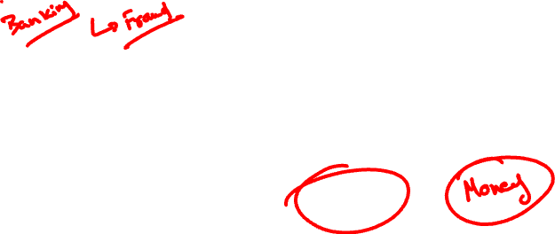
From these scenarios we understand Netflix’s most valuable resource is:
Data
The science of analysis and generation of insights from data is Data Science
Notes:
Put Netflix engineering blog medium(Netflix blog)

Slide 13
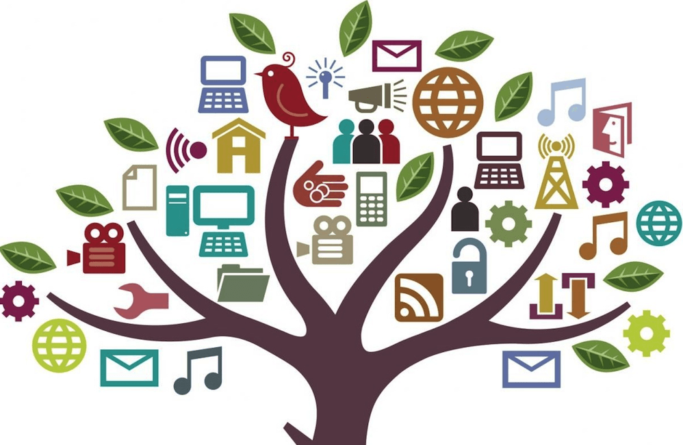
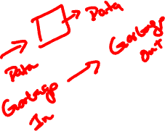
What is Data?
Data are raw ingredients from which statistics are created.
Examples of data include a sequence of bits, a table of numbers, the characters on a page, the recording of sounds made by a person speaking, or a moon rock specimen.“

Slide 14

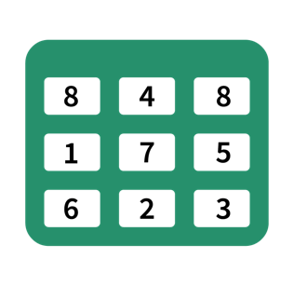
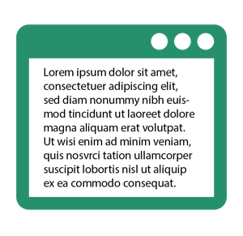



What is Data: Examples
Sequence of bits
Table of Numbers
Characters on a page
Recording of sounds
Moon rock specimen

Slide 15



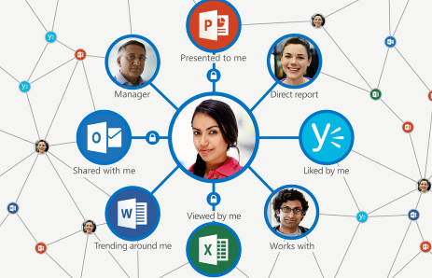
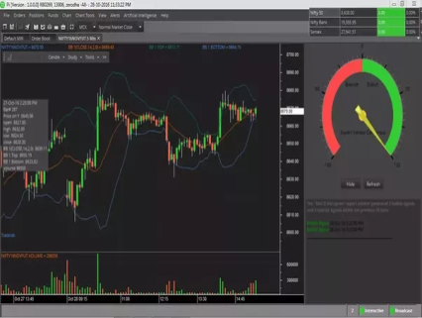


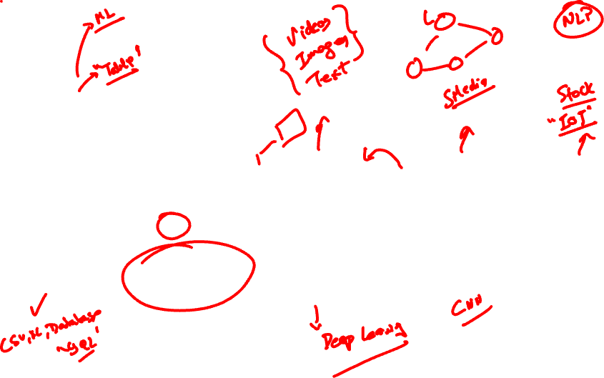
Types of Data
Structured
data
Semi-structured
data
Unstructured
data
Graph
data
Streaming
data

Slide 16
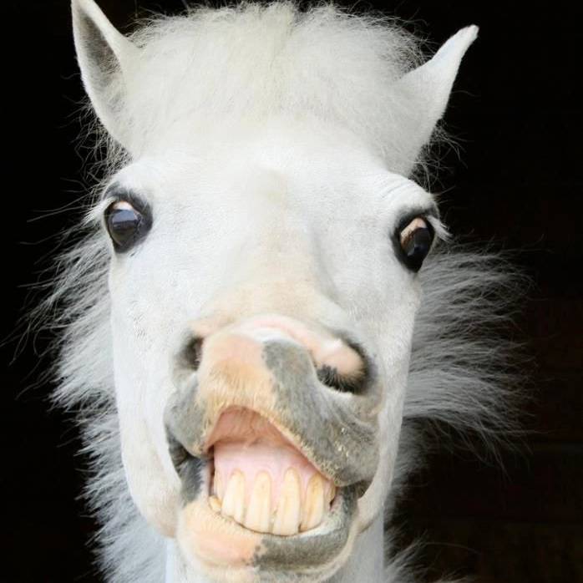


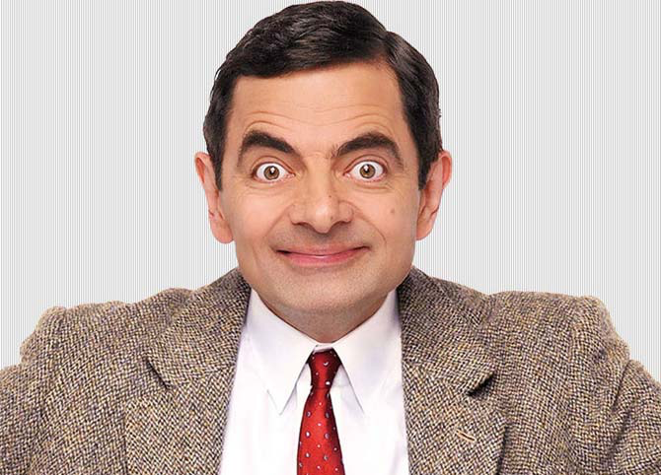

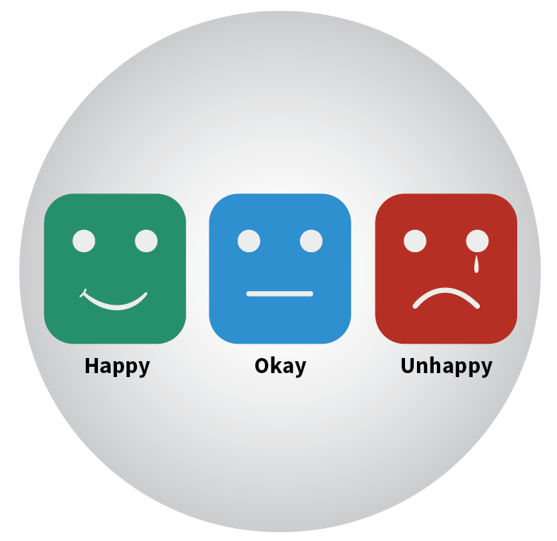

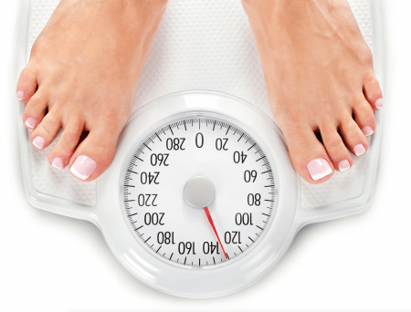
Types of Data: Alternate view
Quantitative
Qualitative
a. Discrete
b. Continuous
a. Nominal
b. Ordinal
Two horses
Height
Male
Female
Customer Service
Interval
Ratio
Time scale
Weight

Slide 17
What is Data Science?

Slide 18
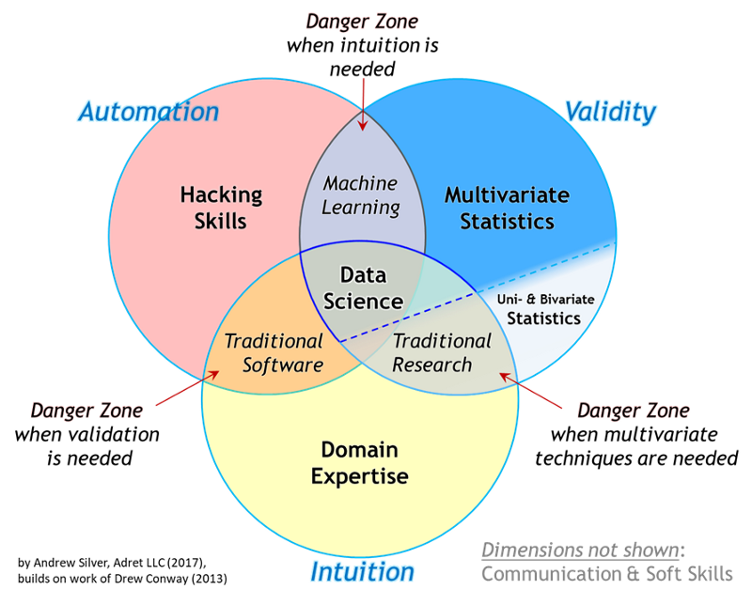
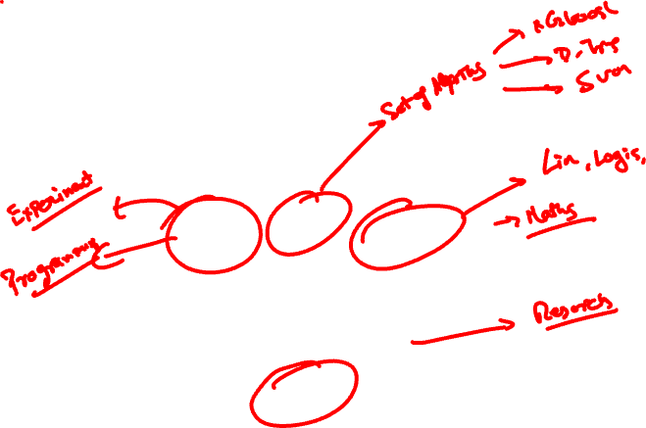
What is Data Science?
Notes:
**new venn diagram to be added (ask Lavi)

Slide 19

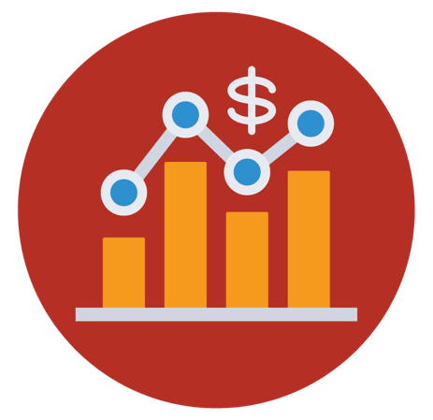

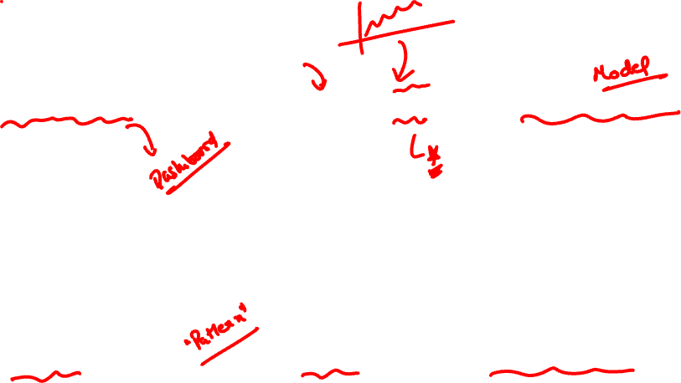
What is Data Science?
Analytics/BI
Data Science(EDA)
Machine Learning
Shows WHAT has happened
Shows WHY it happened
Shows HOW we can predict & automate decision making systems

Slide 20
Who are Data Scientists?

Slide 21
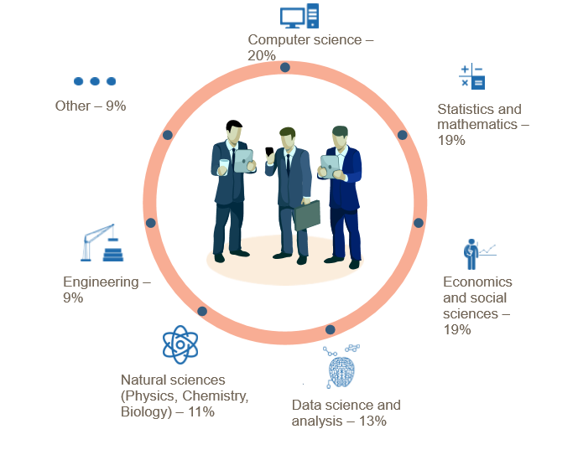
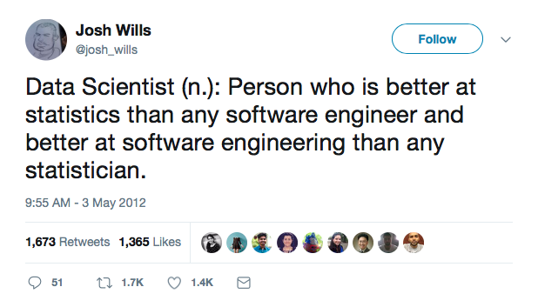
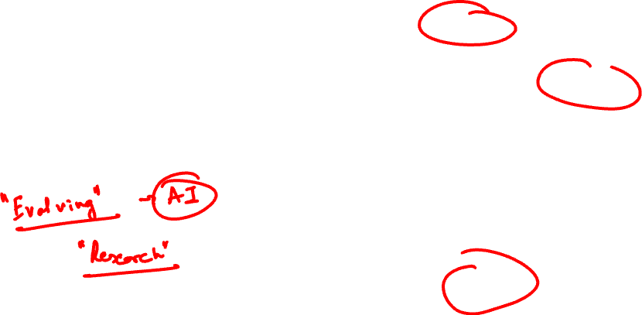
Who is a Data Scientist?
Source: http://wwwis.win.tue.nl/~wvdaalst/data_science/cartoons_New_Breed.jpg

Slide 22
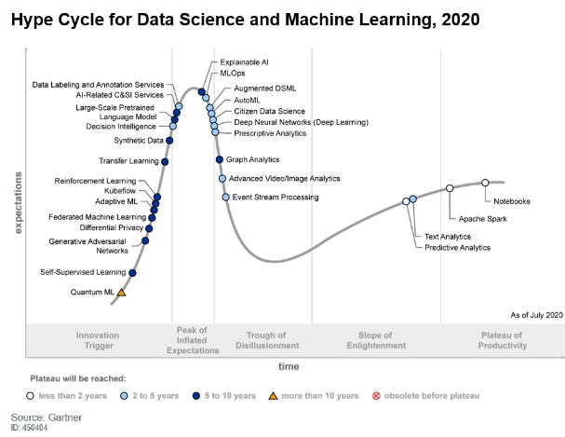
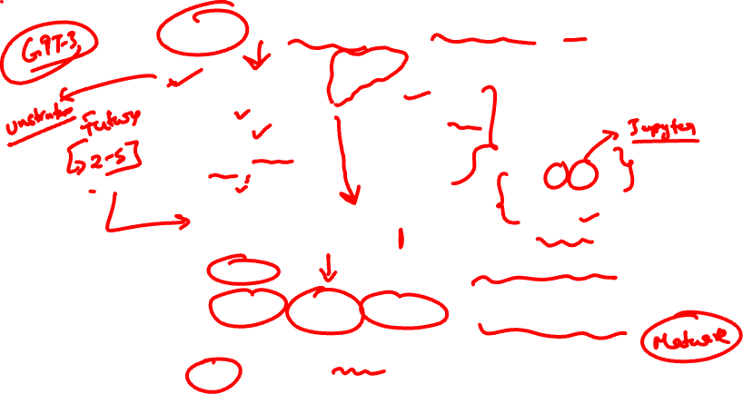
Data Science: Hype or Reality?
Notes:
https://www.linkedin.com/pulse/2018-gartner-hype-cycles-emerging-technologies-data-science-nam-le/

Slide 23
What do Data Scientists do?

Slide 24
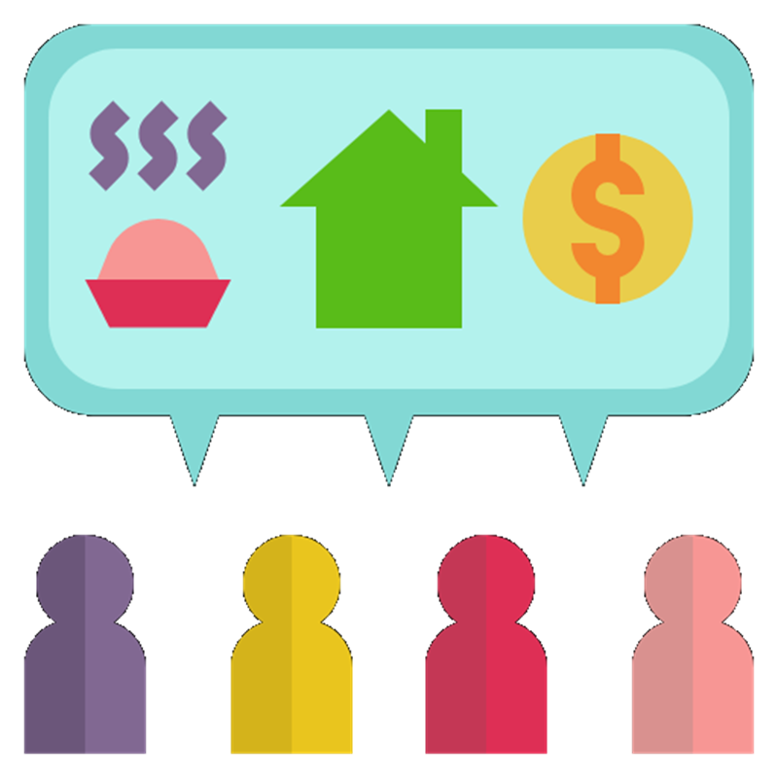
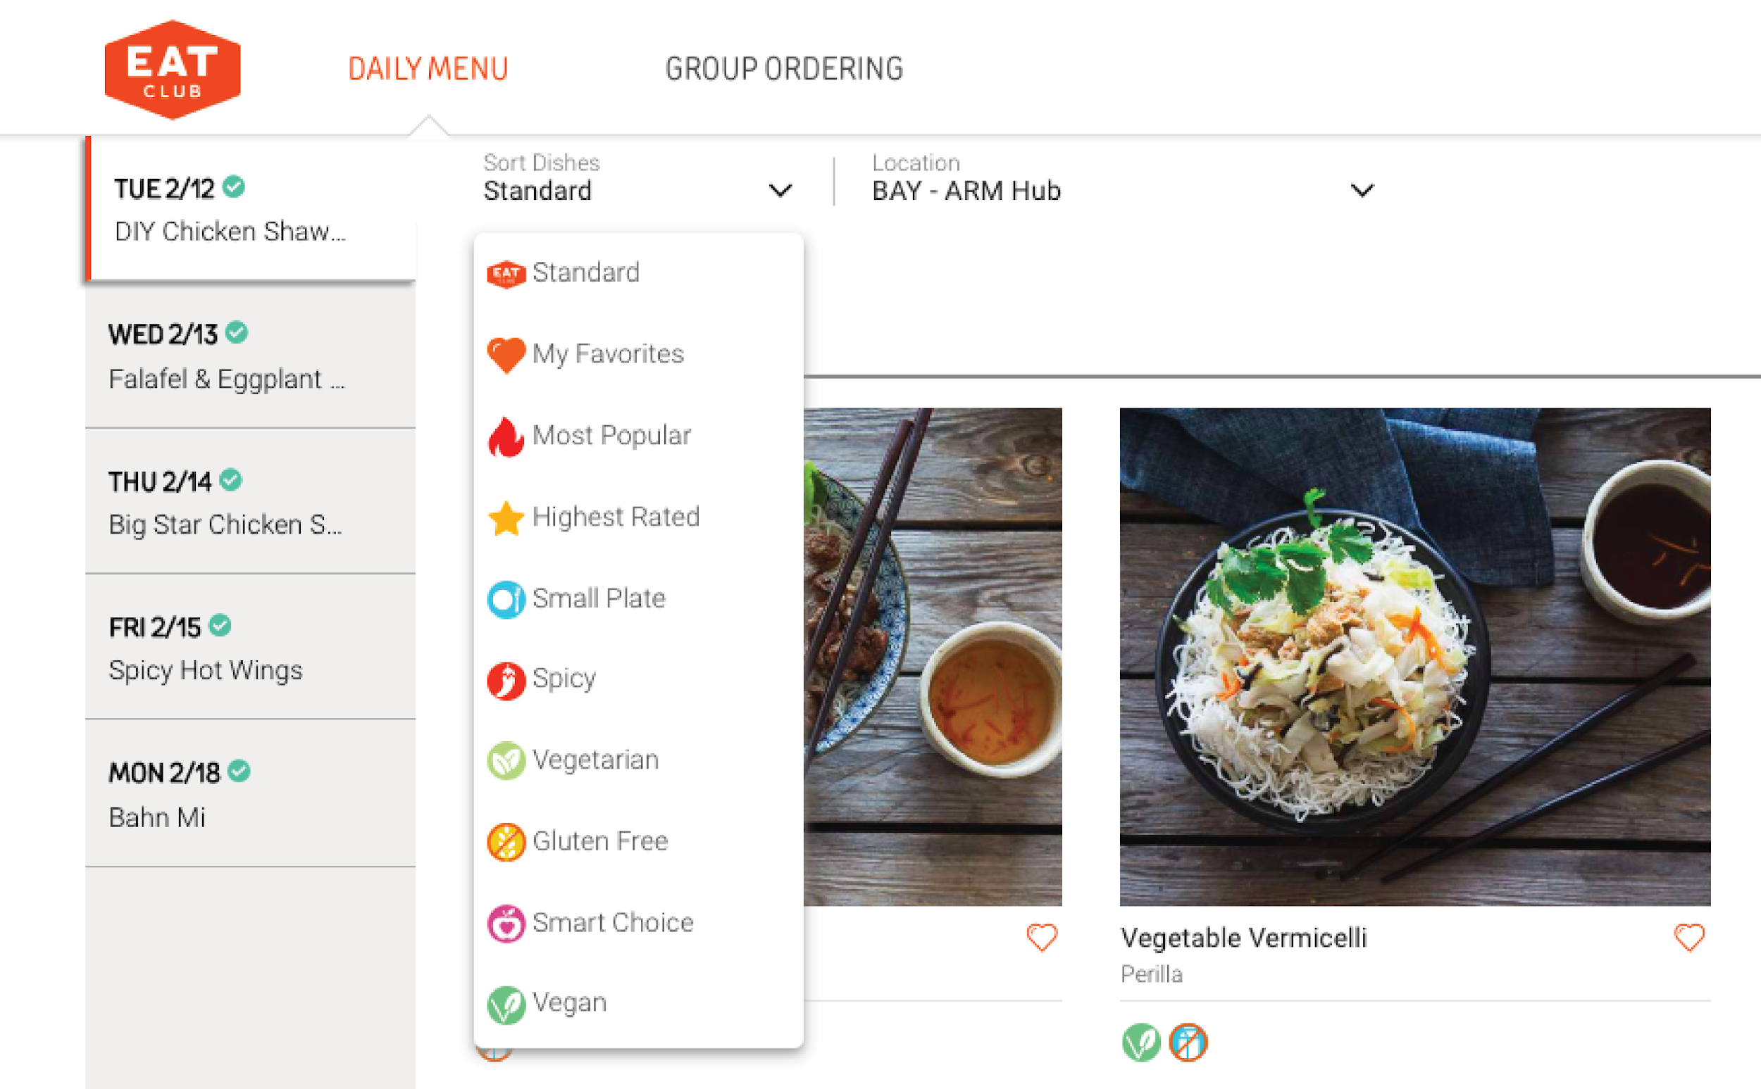


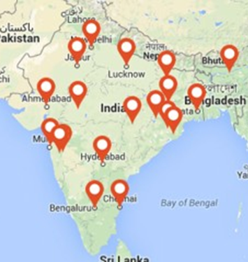
Let’s understand how food delivery apps use data science
To make prediction of demand
Sort customer preferences
To Improve delivery efficiency
To find suitable geographical locations for expansion

Slide 25
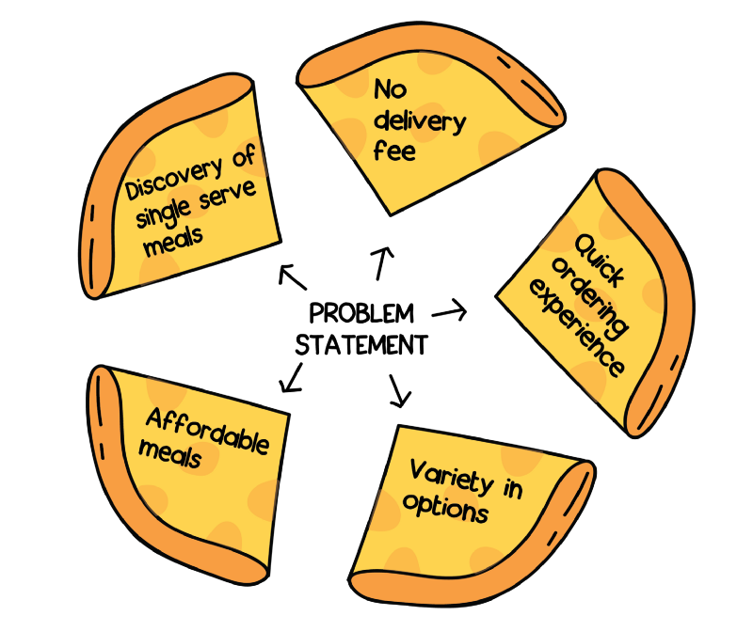
How was Swiggy POP was born?
Problem Statement:
Customers who were ordering food for one person had to go through the pain of choosing from meal options that were usually priced for two.
Delivery fee was high - they didn’t seem to like paying 35 bucks of delivery fee for 100 rupee meal

Slide 26
How was One person meal made affordable?
Data acquisition:
Aim was to find whether there was a market for single serve meals through data by searching for:
item count in a typical Swiggy cart
% of orders which fit into meal-for-one definition
% of orders which fit into meal-for-one definition AND were made from a restaurant offering free delivery
% of order flows which fit into meal-for-one definition BUT had a delivery charge applicable AND were abandoned at the cart
And there was enough data suggesting to solve this single serving meal problem that none of the other competitors had solved
.

Slide 27

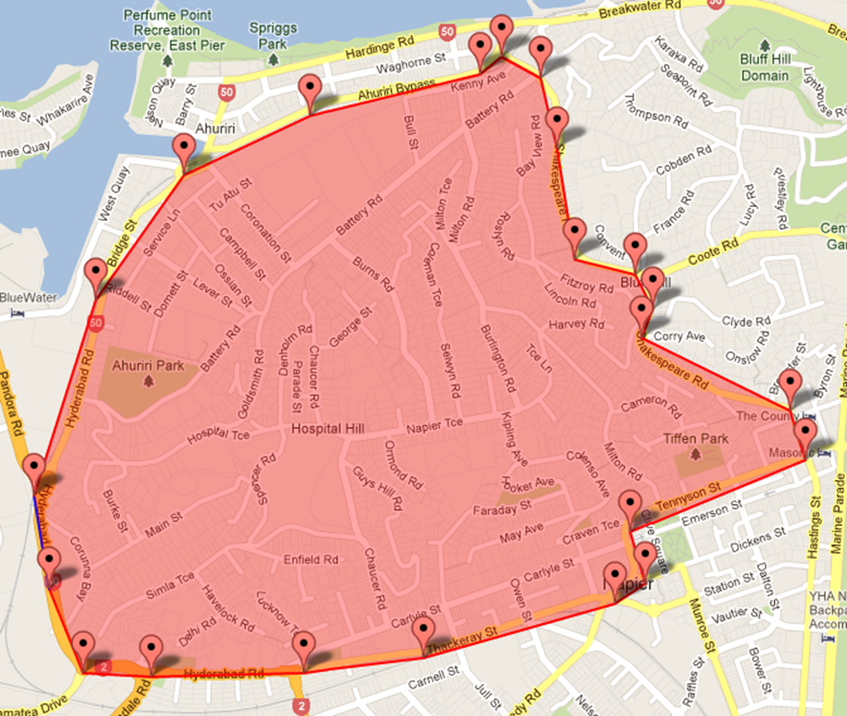



Solution to single serve meals
Make delivery free
Make manual polygons in city such that distance between two farthest points is <3 kms
Make predictable orders so as to reduce restaurant prep time
Enables Lesser delivery time and batch delivery
Pre defined time slots

Slide 28
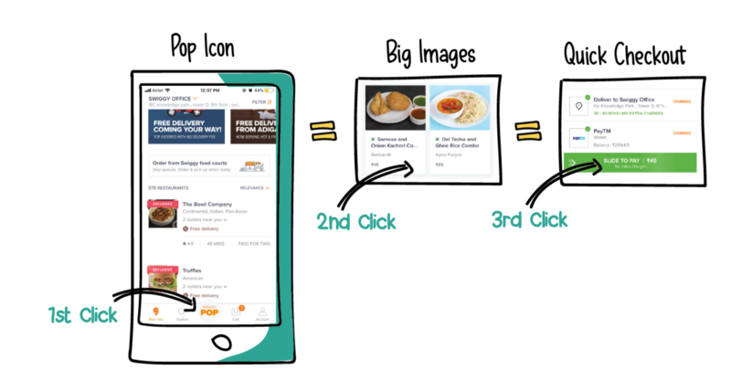
Deployment of Swiggy POP

Slide 29



Let’s understand how ecommerce apps use data science
To predict region wise demand, thus stocking inventory as per the demand
Create algorithms to accurately predict date of delivery by calculating user and product location
Moved from keyword-based search to more semantic-based searches powered by NLP

Slide 30
Deeper Discussions

Slide 31


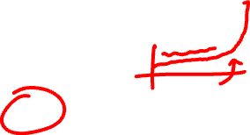
Data Science: Science or Art?
It is more Art and less Science
Ways in which creativity can be expressed in data science include:
applying techniques in unconventional settings.
combining techniques in unconventional ways.
developing new and unusual hypothesis.

Slide 32
Problems that Data Science solves

Slide 33
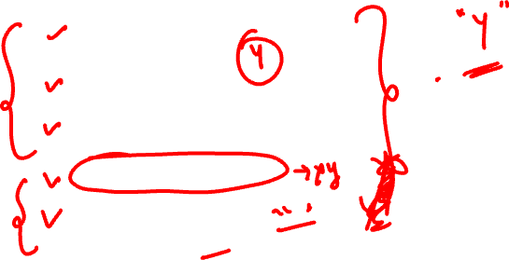
Problems that Data Scientists solve
Is this A or B?
Is this weird?
How much or how many?
How is this organized?
What should I do now?

Slide 34

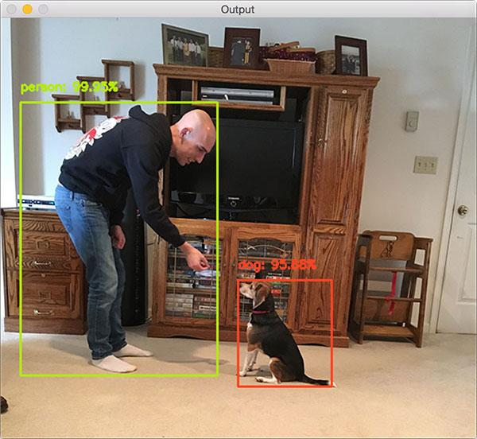
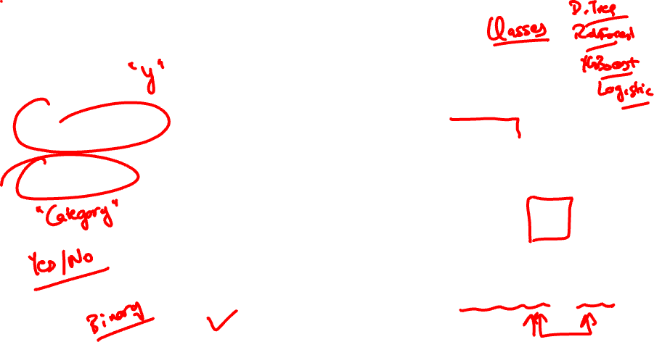
Problems that Data Scientists solve
Is this A or B?
Classification
Will this applicant be able to repay the loan?
Identify a human & a dog?

Slide 35

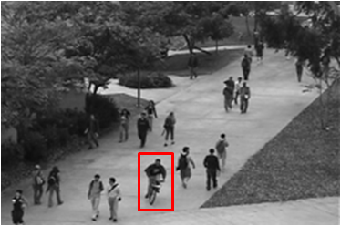

Problems that Data Scientists solve
Is this weird?
Anomaly
Is this mail in your inbox spam?
Is someone riding bike on a walkway?

Slide 36
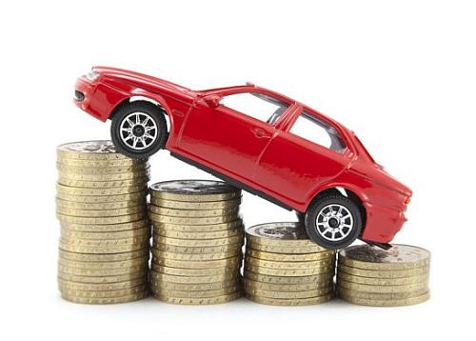


Problems that Data Scientists solve
How much or
How many?
Regression
How much will this used car sell for?
Predict how much product sales will be achieved in this month?

Slide 37


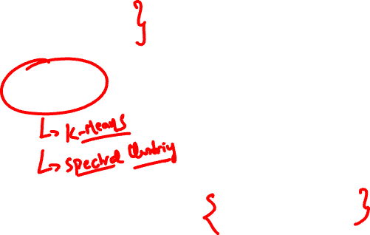
Problems that Data Scientists solve
How is this organized?
Clustering
Which viewers like the same kind of movies?
Which pet owner groups have the same purchase behaviour for pet foods?

Slide 38
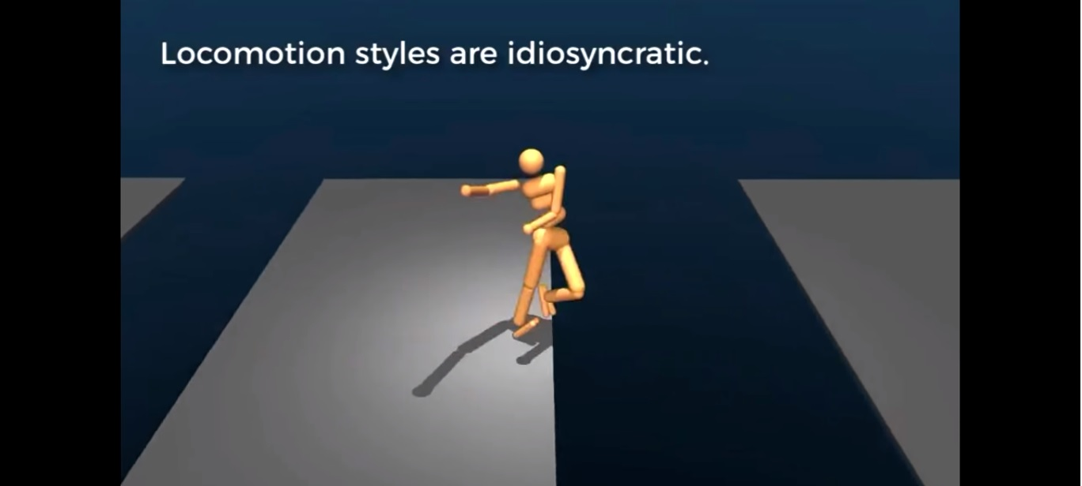
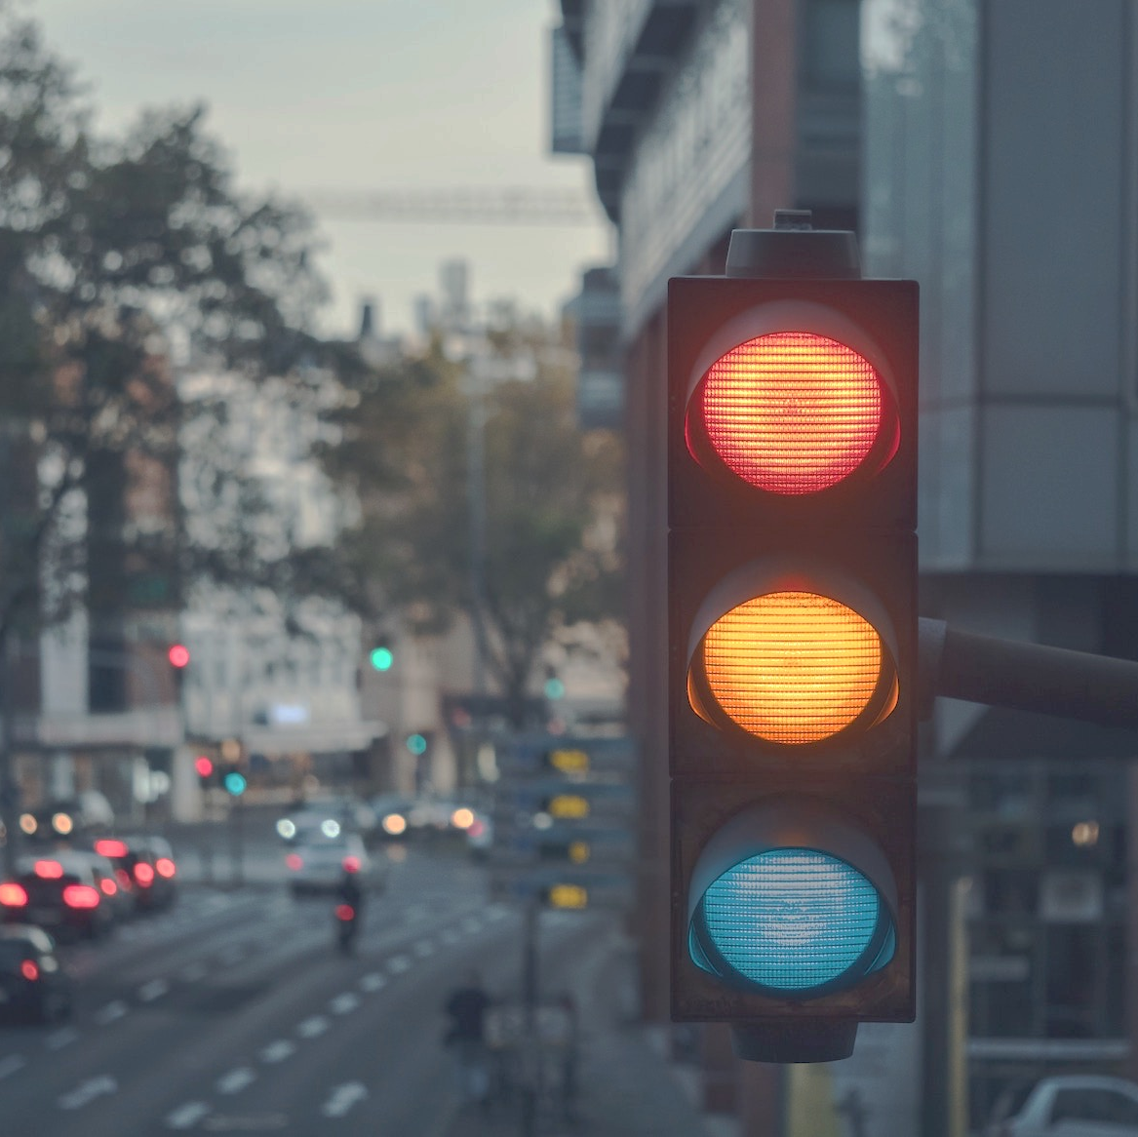

Problems that Data Scientists solve
What should I do now?
Reinforcement learning
How far should the Robot Jump?
Should I break, accelerate, or continue at that yellow light?
Notes:
https://www.youtube.com/watch?v=gn4nRCC9TwQ
Google's DeepMind AI just taught itself to walk

Slide 39
Industry Applications

Slide 40

Applications in Telecom Industry
Customer Acquisition Strategies
Churn Analysis and Control
Up-sell / Cross-sell
Product Bundling

Slide 41
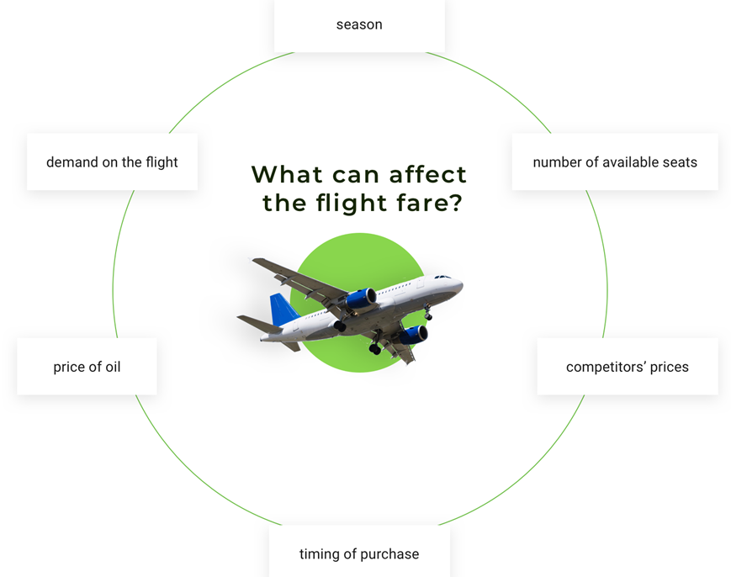
Applications in Travel industry
Predict Flight Delay
Fare estimation using Dynamic Pricing
Airline routes
Effectively Drive Customer Loyalty
Notes:
Through data science flight delays can be predicted using historical data
Dynamic pricing of flights also depend on various external factors like day of booking, how close it is to the departure date, seasonal cycles and so on
Optimize airline routes using machine learning
Improve customer loyalty by offering targeted flight promotional offers

Slide 42
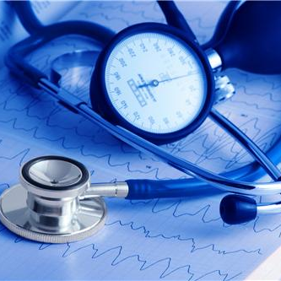
Applications in Healthcare Industry
Clinical trials of new drugs
A / B Testing
Genetics Analysis
Epidemic Forecasting and Control

Slide 43

Applications in Energy and Utilities
Predictive maintenance for machinery
Predict theft and loss prevention
Churn analysis and prevention
Auto balance resources and dynamic routing

Slide 44

Applications in Banking and Finance
Fraud detection and prevention
Customer Segmentation
Risk management
Portfolio Optimization

Slide 45

Applications in Manufacturing
Custom product design
Better quality assurance
Improve manufacturing processes
Managing supply chain risk

Slide 46
Data Science Project Life Cycle

Slide 47
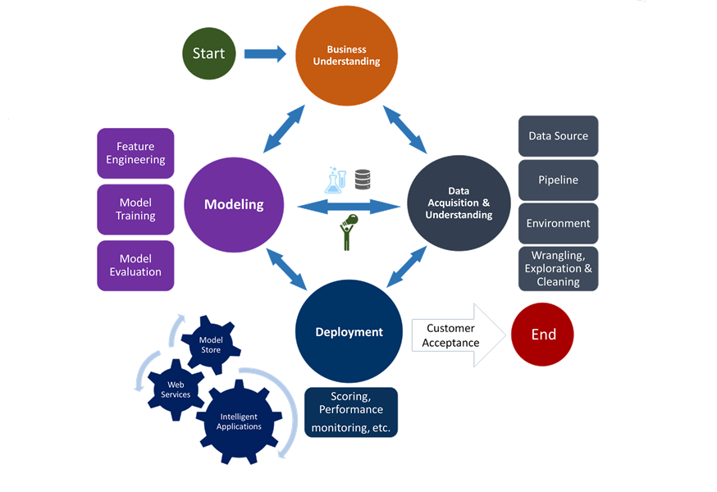
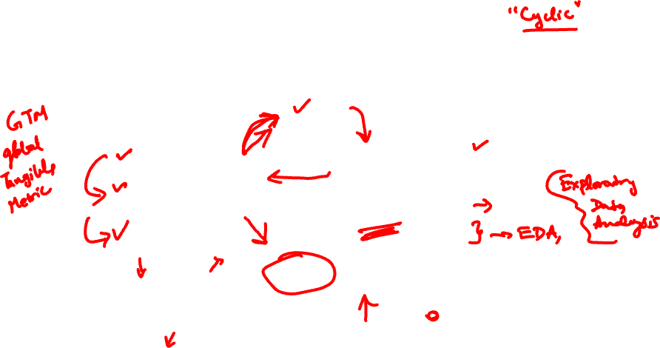
How do I start a Data Science project?
Notes:
**add updated (ask Lavi)

Slide 48
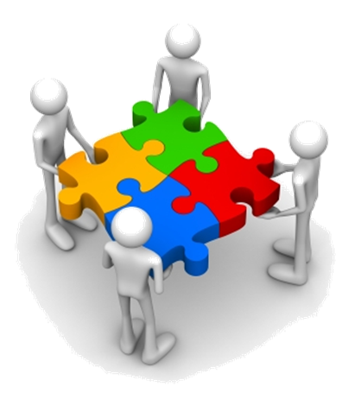


Step 1: Business Understanding
#4
Evaluate & critique model
#5
Present results and document
#3
Build the model
#6 Deploy Model
Deploy the model to solve the problem in the real world
Deploy the model as a product to be used in real world. E.g. Amazon recommendation
Define Objectives
Work with customer and other stakeholders to understand and identify business problems
Business Goals
Formulate questions that define business goals that the data science techniques can target.
Identify data sources
Find the relevant data that helps you answer the questions.
#2
Collect and Manage Data
#7
Continuous improvement process
#1
Define the goal

Slide 49
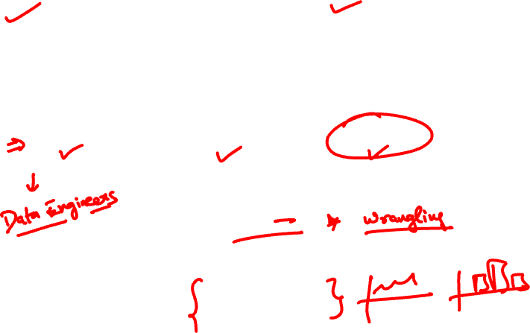
Step 2: Data Acquisition and Understanding
Data Acquisition and Understanding
Ingest Data
Explore Data
Data Pipeline
Data Pre-processing
Exploratory Data Analysis
Notes:
**add updated (ask Lavi)

Slide 50





Step 2: Ingest Data
#4
Ingest raw data into your analytic environment once data source is found
Raw data means data that has not been changed since acquisition
This raw data is stored in your storage systems.
Evaluate & critique model
#5
Present results and document
#3
Build the model
#6 Deploy Model
SQL Databases
Hadoop
NoSQL Databases
#2
Collect and Manage Data
#7
Data warehouses
Continuous improvement process
#1
Define the goal

Slide 51


Step 2: Data Pre-Processing
As a Data Scientist, a lot of your time will go in Data pre-processing.
Also known as Data cleaning
This step includes dealing with
Outliers
Missing values
Malicious Data
Erroneous Data
Irrelevant Data
Inconsistent Data
Formatting

Slide 52


Step 2: Data Pre-Processing – contd..

Slide 53

Step 2: Data Pre-Processing - contd..
Once Data is cleaned, it needs to be processed to make it ready for use.
This stage includes
#4
Sorting
Evaluate & critique model
#3
Build the model
Classification
#6 Deploy Model
Summarization
Deploy the model to solve the problem in the real world
Deploy the model as a product to be used in real world. E.g. Amazon recommendation
#2
Collect and Manage Data
#7
Validation
Aggregation
Continuous improvement process
#1
Define the goal
Data Pre-processing(Data cleaning) is at times considered to be part of Data Processing

Slide 54

Step 2: Data Pre-Processing - contd..

Slide 55


Step 2: Exploratory Data Analysis

Slide 56


Step 2: Exploratory Data Analysis

Slide 57

Step 2: Exploratory Data Analysis

Slide 58

Step 2: Set up a Data Pipeline
Set up a data pipeline that cleans and explores new data as part of an ongoing learning process.
Pipeline can be batch based, streaming(real time) or a hybrid of both.

Slide 59


Step 3: Modeling & Algorithms
Split data into train and test
Build multiple models to solve the business problem
Evaluate models using test data and error metrics
Choose “best” model by comparing models to see which one comes closest to answering business objective

Slide 60


Step 4: Deployment
Seek management’s consideration for deploying the solution to real world to help make the business more optimized and beneficial.
Choose the best performing models and deploy them with an open API interface. The interface enables the model to be easily consumed from various applications, such as
1. Online websites
2. Dashboards
3. Spreadsheets
4. Back-end applications
Notes:
torm with management and showcase the benefit the analysis and models bring to the plate.

Slide 61


Step 4: Take action & deploy the findings in real world
Deploy the model in production
Measure the metrics
Continue improvement till business goal is achieved
For example, it could be better fraud detection rate, higher upsells through recommendation
Notes:
** Add model explanation,model production

Slide 62

Step 5: Customer Acceptance
System validation: Confirm that the deployed model and pipeline meet the customer's needs.
Project hand-off: Hand the project off to the entity that's going to run the system in production.

Slide 63


What is Machine Learning?
Machine learning is the science that allows computers to learn directly from data through examples and experience.
Notes:
Machine learning is the process wherein machines learn by examples ,experience and discovery through DATA.

Slide 64
Let’s compare between Traditional programming and Machine Learning..

Slide 65
Pros and Cons of Traditional programming
Pros
Easier to read and understand
Error analysis is simpler
Cons
Rule based systems
Fails in many outside test scenarios
Hard coding becomes difficult for humongous data
Notes:
Machine learning is the process wherein machines learn by examples ,experience and discovery through DATA.

Slide 66


Traditional Programming vs Machine Learning
07

Slide 67


Top Machine learning terminologies to start with…

Slide 68

Term 1: Features
The number of distinct traits that can be used to describe each item in a quantitative manner.
Features-Distinct traits that decide taste of a mango
Output Feature variable- Taste of a mango
 | Color | Size | Shape | Which vendor | Which part of the country | Taste
Mango 1 | Yellow | Big | Oval | Local | Amritsar | Ripe
Mango 2 | Green | Small | Round | Foreign | England | Sweet
Mango 3 | Yellow | Small | Round | Local | Amritsar | Juicy

Slide 69






Term 2: Samples
A sample is an item to process. For instance, it could be an document, picture, sound, or a raw database.

Slide 70

Term 3: Feature vector
A feature vector is an n-dimensional vector of numerical features that represent some object
.
 | Color | Size | Shape | Which vendor | Which part of the country | Taste
Mango 1 | Yellow | Big | Oval | Local | Amritsar | Ripe
Mango 2 | Green | Small | Round | Foreign | England | Sweet
Mango 3 | Yellow | Small | Round | Local | Amritsar | Juicy
Feature vector- [Yellow,Big,Oval,Local,Amritsar,Ripe]

Slide 71


Term 4: Feature Extraction
Preparation of feature vector
Transforms the data from high-dimensional space to a space of fewer dimensions.
.
 | Color | Size | Shape | Which vendor | Which part of the country
Mango 1 | Yellow | Big | Oval | Local | Amritsar
Mango 2 | Green | Small | Round | Foreign | England
Mango 3 | Yellow | Small | Round | Local | Amritsar
Transforming 5D to 1D
Sweet
Juicy
Ripe
Notes:
** Try to have more meaningful representation such as highlight an actual data set and show which point is which part

Slide 72

Term 5: Training set
Set of data to discover potentially predictive relationships.
.
.
Training Data
 | Color | Size | Shape | Which vendor | Which part of the country | Taste
Mango 1 | Yellow | Big | Oval | Local | Amritsar | Ripe
Mango 2 | Green | Small | Round | Foreign | England | Sweet
Mango 3 | Yellow | Small | Round | Local | Amritsar | Juicy

Slide 73

Term 6: Test set
Set of data to validate the predictive relationship
Test Data
Mango 4 | Green | Big | Oval | Foreign | England | ?
Predictions are produced using the model

Slide 74

Term 7: Scoring
Evaluating the performance of a machine learning based on any statistical metric.
.
.
Accuracy

Slide 75






General Machine Learning process flow
Learning Algorithm
Training
Data
Produce a Model
Data
Test Data
Accuracy
Test Data
Test Data

Slide 76




Types of Machine learning
Supervised learning
Unsupervised learning
Reinforcement learning
20
Notes:
** change images for both usupervised and reinforcement

Slide 77






Supervised Learning: Learn from Examples
Supervised machine learning enables computers to learn from labeled data without being explicitly programmed.
Known data
Model
New response
It’s an apple
Known response
These are apples
21
New data

Slide 78





Unsupervised Learning: Uncover hidden patterns
Unsupervised learning draws inferences from data without labeled responses.
I can see patterns
Known data
Model
21

Slide 79






Supervised vs Unsupervised Learning
Supervised
Unsupervised
Direct Feedback
Labeled Data
No Feedback
Non-Labeled Data
Predictions as output
Find hidden structure in data

Slide 80


Reinforcement Learning: Learn by interaction with environment
Reinforcement learning develops algorithms when in direct interaction with environment and tunes itself from its mistakes using feedback.
Reinforced response
It’s a mango
Wrong! It’s an apple.
Noted!
It’s an apple!
Input
Response
Feedback
Learns
Input
21

Slide 81




Types of problems solved through Machine learning
Regression
Classification
Clustering

Slide 82
Types of problems solved through Machine learning
Regression
Classification
Supervised Learning
Clustering

Slide 83




An example illustrating regression
A study is conducted by Stanford University in order to understand how the number of years of higher education affect the annual income of their graduated students.
Predict what would be annual income for 3 years of higher education

Slide 84






An example illustrating Classification
John wants to undertake a loan from Bank Of India in order to purchase a house. Banks conduct a thorough investigation about the person who desires to take a loan before granting one.
Will bank approve loan or not?
Yes No

Slide 85
Types of Problems solved through Machine learning
Regression
Classification
Clustering
Unsupervised Learning
22

Slide 86



Clustering topics in Google news
Categorization of news articles in Google news.
Notes:
Categorization of news articles on Google news.

Slide 87


Clustering: Selling products to the right category of customers

Slide 88

Steps in a machine learning workflow
Model Objective
Model Evaluation
Gathering Data
Train the data
Data Preparation
Choose a model
23

Slide 89



Step 1: Model objective
Classify animals into fish, mammal and bird
Fish
Bird
Mammals
23

Slide 90
Step 2: Gathering Data
Animal name | feathers | airborne | aquatic | toothed | backbone | breathes | venomous | fins | legs | tail | class type
dogfish | 0 | 0 | 1 | 1 | 1 | 0 | 0 | 1 | 0 | 1 | Fish
dolphin | 0 | 0 | 1 | 1 | 1 | 1 | 0 | 1 | 0 | 1 | Mammal
dove | 1 | 1 | 0 | 0 | 1 | 1 | 0 | 0 | 2 | 1 | Bird
duck | 1 | 1 | 1 | 0 | 1 | 1 | 0 | 0 | 2 | 1 | Bird
elephant | 0 | 0 | 0 | 0 | 1 | 1 | 0 | 0 | 4 | 1 | Mammal
flamingo | 1 | 1 | 0 | 0 | 1 | 1 | 0 | 0 | 2 | 1 | Bird
23

Slide 91

Step 3: Data Pre processing
Animal name | feathers | airborne | aquatic | toothed | backbone | breathes | venomous | fins | legs | tail | class type
dogfish | 0 | 0 | 1 | 1 | 1 | 0 | 0 | 1 | 0 | 1 | Fish
dolphin | 0 | 0 | 1 | 1 | 1 | 1 | 0 | 1 | 0 | 1 | Mammal
dove | 1 | 1 | 0 | 0 | 1 | 1 | 0 | 0 | 2 | 1 | Bird
duck | 1 | 1 | 1 | 0 | 1 | 1 | 0 | 0 | 2 | 1 | Bird
elephant | 0 | 0 | 0 | 0 | 1 | 1 | 0 | 0 | 4 | 1 | Mammal
flamingo | 1 | 1 | 0 | 0 | 1 | 1 | 0 | 0 | 2 | 1 | Bird
The features backbone, venomous and tail have same values for all animals and can thus be discarded.
23

Slide 92
Step 4: Choose a model
Animal name | feathers | airborne | aquatic | toothed | breathes | fins | legs | class type
dogfish | 0 | 0 | 1 | 1 | 0 | 1 | 0 | Fish
dolphin | 0 | 0 | 1 | 1 | 1 | 1 | 0 | Mammal
dove | 1 | 1 | 0 | 0 | 1 | 0 | 2 | Bird
duck | 1 | 1 | 1 | 0 | 1 | 0 | 2 | Bird
elephant | 0 | 0 | 0 | 0 | 1 | 0 | 4 | Mammal
flamingo | 1 | 1 | 0 | 0 | 1 | 0 | 2 | Bird
Choose any supervised learning algorithm since it has known labels.
Since labels are categorical, go for any classification algorithm.
23

Slide 93


Step 5: Train data
Animal name | feathers | airborne | aquatic | toothed | breathes | fins | legs | class type
dogfish | 0 | 0 | 1 | 1 | 0 | 1 | 0 | Fish
dolphin | 0 | 0 | 1 | 1 | 1 | 1 | 0 | Mammal
dove | 1 | 1 | 0 | 0 | 1 | 0 | 2 | Bird
duck | 1 | 1 | 1 | 0 | 1 | 0 | 2 | Bird
elephant | 0 | 0 | 0 | 0 | 1 | 0 | 4 | Mammal
flamingo | 1 | 1 | 0 | 0 | 1 | 0 | 2 | Bird
Produce a Model
Test Data
Feed training data
Training Data
23

Slide 94


Step 6: Model Evaluation
Predict unknown test data using trained model and check if predictions are correct.
Model
Predictions
Mammal
Feed test data
Bird

Slide 95


How good or bad your model is: Let us evaluate
The following metrics are used to measure model performance.
MAE: Mean absolute Error
MSE: Mean Squared Error
RMSE: Root Mean Squared Error

Slide 96

Mean Absolute Error(MAE)
MAE is the average absolute difference between actual and predicted values.
Characteristics:
Neutral to outliers
Error is in same units as that of the data points.
Notes:
To calculate MAE;
First calculate the absolute difference between original and predicted value.
Sum all the errors
Divide by the total number of observations

Slide 97

Mean Squared Error(MSE)
MSE is the average squared difference between actual and predicted values.
Characteristics:
Accounts impact of outliers.
Error is NOT in same unit as that of the data points .
Notes:
To calculate MSE;
First calculate the square of the difference between original and predicted value.
Sum all the squared errors
Divide by the total number of observations
Each error is squared- (yi – ŷ)².
Find the sum of each squared error- ∑ (yi – ŷ)².
Find mean by dividing the sum with no. of observations(n)- ∑ (yi – ŷ)²/n.

Slide 98

Root Mean Squared Error(RMSE)
RMSE is the square root of the average squared difference between actual and predicted values.
Characteristics:
Accounts impact of outliers.
Error is in same unit as that of the data points.
Notes:
To calculate RMSE;
First calculate the square of the difference between original and predicted value.
Sum all the squared errors
Divide by the total number of observations
Find the square root of the resulting value
Each error is squared- (yi – ŷ)².
Find the sum of each squared error- ∑ (yi – ŷ)².
Find mean by dividing the sum with no. of observations(n)- ∑ (yi – ŷ)²/n.
Finally find the root- √ ∑ (yi – ŷ)²/n.

Slide 99


What is Classification accuracy?
Classification accuracy is number of correct predictions made divided by total number of predictions.

Slide 100



Let’s have a look at Sam’s email account
Email account contains a total of 10000 emails with 9671 genuine emails and 329 spam emails.
Email
……..
……
Ham
Spam
9671
329
Notes:
.

Slide 101

Let’s build a spam classifier model
After passing email data through the model we correctly classify 9544 emails as ham and 160 emails as spam.
Email
……..
……..
……
Ham
Spam
9544
160
Notes:
Suppose Sam’s email account contains 9671 genuine emails and 329 spam emails.
Let’s build a spam classifier that classifies all emails as genuine

Slide 102

Hurrah a 97 % accuracy!
But what is wrong with this?
Let’s find out…

Slide 103

What if we build a model to classify all emails as ham?
For a model that classifies all emails as ham, all ham emails are correctly classified whereas
all spam emails are wrongly classified.
……..
……..
……
Ham
Ham
9671
329
Notes:
There is not much difference between the accuracies of the dumb model and our original model.

Slide 104







No significant difference in accuracy between models
Dumb Model: Predict all are ham
Original Model
…
…
...
…
Ham
Spam
Ham
Spam
9671
329
9544
160
It is evident that accuracy for a dumb model is not much different from our original model.

Slide 105

No significant difference in accuracy between models
In cases where there is imbalance in data, accuracy is not an adequate metric to explain performance of model.
Spam
Ham
329
9671
Notes:
.

Slide 106
Lets solve drawbacks of classification accuracy by confusion matrix…

Slide 107




Let’s consider a medical model
Jones’ hospital has revamped its medical facilities and wants to analyze if it is making correct diagnosis using its newly imported medical equipment.

Slide 108

Confusion matrix
A confusion matrix is a table that helps understand performance of a classification model on test data for which true values are known.
Predicted classes
 | Diagnosed Healthy | Diagnosed Sick
Healthy | 118 | 12
Sick | 47 | 15
Actual classes
Notes:
The number of correct and incorrect predictions are summarized with count values and broken down by each class.
The confusion matrix shows the ways in which your classification model is confused when it makes predictions.
It gives you insight not only into the errors being made by your classifier but more importantly the types of errors that are being made.

Slide 109
Performance measures derived from confusion matrix
Confusion Matrix
True Negative
False Positive
True Positive
False Negative
Specificity
Precision
Sensitivity or Recall

Slide 110
Performance measures obtained from confusion matrix
Predicted classes
 | Event | No Event
Event | True positive | False Negative
No Event | False Positive | True Negative
True positive: Number of correctly predicted event values.
False positive: Number of incorrectly predicted event values.
True negative: Number of correctly predicted no-event values.
False negative: Number of incorrectly predicted no-event values.
Actual classes
.
.
Notes:
Suppose there are three classes,

Slide 111
Confusion matrix for a medical model
Predicted classes
 | Diagnosed Healthy | Diagnosed Sick
Healthy
Sick
True Positives (TP): Healthy people correctly predicted as Healthy
False Positives (FP): Healthy people incorrectly predicted as Sick
True positive
False positive
Actual classes
False Negatives (FN): Sick people incorrectly predicted as Healthy
True Negatives (TN): Sick people correctly predicted as Sick
False negative
True
negative
Notes:
Confusion matrix displays count of actual and predicted classifications.

Slide 112
Let’s revisit spam classifier model
After passing email data through the model we correctly classify 9544 emails as ham and 160 emails as spam.
Email
……..
……
Ham
Spam
9544
160
Notes:
Suppose Sam’s email account contains 9671 genuine emails and 329 spam emails.
Let’s build a spam classifier that classifies all emails as genuine

Slide 113

Confusion matrix for a spam classifier model
Predicted classes
 | Spam | Ham
Spam
Ham
True Positives (TP): spam correctly predicted as spam
False Positives (FP): spam incorrectly predicted as ham
True positive
False negative
Actual classes
False Negatives (FN): ham incorrectly predicted as spam
True Negatives (TN): ham correctly predicted as ham
False positive
True
negative
Notes:
Confusion matrix displays count of actual and predicted classifications.

Slide 114
Confusion matrix for a spam classifier model
Predicted classes
 | Spam | Ham
Spam |  | 169
Ham | 127 | 9544
160
True positive
False negative
Actual classes
False positive
True
negative
Notes:
Confusion matrix displays count of actual and predicted classifications.

Slide 115
Significance of performance measures on two models
Medical Model
Spam Classifier Model
False Positive False Negatives
Diagnosing a sick person as healthy is dangerous.
False Negatives False Positives
Classifying an important email as spam is not desirable.
Notes:
Cross and tick

Slide 116
Few other performance measures derived from confusion matrix
Confusion Matrix
True Negative
False Positive
True Positive
False Negative
Specificity
Precision
Sensitivity or Recall

Slide 117

Recall
Recall also known as sensitivity is a measure of how often predictions are correct when actual value is positive.
Predicted classes
 | Spam | Ham
Spam |  | 169
Ham | 127 | 9544
Of the mails that are actually spam, how many are classified as spam?
160
True positive
False negative
Actual classes
False positive
True
negative
Notes:
Recall and Precision are disjoint sets of measures.

Slide 118

Specificity
Specificity is a measure of how often predictions are correct when actual value is negative.
Predicted classes
 | Spam | Ham
Spam |  | 169
Ham | 127 | 9544
Of the mails that are actually ham, how many are classified as ham?
160
True positive
False negative
Actual classes
False positive
True
negative
Notes:
Recall and Precision are disjoint sets of measures.

Slide 119

Let’s talk about Precision
Precision is a measure of how often predictions are correct when predicted value is positive.
Predicted classes
 | Spam | Ham
Spam |  | 169
Ham | 127 | 9544
Of the mails classified as spam, how many are actually spam?
160
True positive
False negative
Actual classes
False positive
True
negative

Slide 120













Analogy to Precision and Recall through apples
Suppose Sam visits a fruit stand to buy apples—but more specifically, search criteria was “red, medium-sized fruit.”
apple
apple
Bell pepper
watermelon
Pomegranate
banana
pineapple
Large tomato
apple
apple
lemon
kiwi
large apple
Notes:
Cross and tick

Slide 121









Precision of finding apples
Precision is percentage of the results that are correct.
3 of the 6 results are apples, so Precision of this resulting set is (3 ÷ 6) × 100, or 50%
apple
apple
Bell pepper
watermelon
Pomegranate
banana
pineapple
Large tomato
apple
apple
large apple
lemon
kiwi
Notes:
Cross and tick

Slide 122
Recall of finding apples
There are 5 apple choices among the 13 fruits types available at the stand.
Recall is percentage of correct items that are returned in the search results.
The Recall for apple search is (3 ÷ 5) × 100, or 60%.
apple
apple
Bell pepper
watermelon
Pomegranate
banana
pineapple
Large tomato
apple
apple
lemon
kiwi
large apple
Notes:
Cross and tick

Slide 123
An example where Precision and Recall is used…

Slide 124


Recall and Precision for Google search engine
12.1 million
2 million relevant results
6 million relevant results NOT returned by Google
Recall=Probability of Google’s algorithm to retrieve all the relevant links = 2/(2+6)=0.25
Precision=Probability that all retrieved links were relevant = (2/12.1)=0.165.
Notes:
Let’s say we searched on Google for “what is precision and recall?” and in less than a minute I have about 12.1 million results.
Let’s say out of these 12.1 million results, the relevant links to my question were about 2 million. Assuming there were also about 6 million more results that were relevant but weren’t returned by Google, for such system we would say that it has a precision of 2M/12.1M and a recall of 2M/8M.

Slide 125

Black Box Models
This is how Machine Learning Engineers explain model outputs to people.

Slide 126


Informed Decision Making
Machine Learning model predicts a cancer. But why?
You cannot explain why it gets a certain output.

Slide 127

Fixing bugs in model
It is important to identify the mistakes made by the model and take steps to fix it.

Slide 128



Machine Learning models without explanations
The model predicted that this person will default loan payment.
Notes:
John goes to a bank for a car loan. But his loan application gets rejected.
He wants to speak to the manager who just replies that it is just an output of ML model and he cant explain why?

Slide 129
Accuracy vs Explainability Trade-offs
If the bank uses simple models like Logistic Regression or Decision Tree they can easily explained.
These are basic models with standard performance.
If the bank uses complex models like XGBoost and Deep Learning they can obtain really good accuracy.
These models are black box models with no explanations.
We have to choose between accuracy and interpretable model

Slide 130

Machine Learning models with explanations
The model rejected the loan application due to poor credit score.
Notes:
The manager has an explainer which can explain that the model rejected the application due to poor credit score.

Slide 131
SHAP Package
SHAP (SHapley Additive exPlanations) is a unified approach to explain the output of machine learning models.
It beaks down a prediction to show the impact of each variable.

Slide 132

Shapley Values
Shapley Values or Shap values is a technique used in game theory to determine how much each player in a collaborative game has a contribution to its success.
In our case Shap values are used to measure how much each feature in the model contributes to the prediction.
Notes:
https://towardsdatascience.com/one-feature-attribution-method-to-supposedly-rule-them-all-shapley-values-f3e04534983d

Slide 133


How do SHAP works?
The basic idea is to train a much simpler and interpretable model(i.e. a linear model or decision tree) on top of the originally trained model so that it approximates the original predictions.
These predictions can now be explained by the simpler model.

Slide 134

Prediction Explainer
Shap is used to explain individual predictions and the impact of each feature on the predictions.
In this example looking at a model trained on Pima Indian Dataset and we check if a person is at a risk of diabetes or not.
We predict that there is a 0.2% chance to be diabetic compared to base probability of 0.34%
The probability is low because BMI = 25 and Glucose = 109 which are normal levels in healthy person
This probability is increased due to Skin Thickness = 27 and Pregnancies = 6

Slide 135

Dependence Plot
This tells us how Glucose and Insulin are dependent on one another in terms of their impact on the model.
Glucose is linearly correlated with diabetes.
Glucose below 125, Shap values are negative and probability of diabetic decreases.
Red and blue points are not separable and hence glucose cannot alone explain the probability of diabetes. We need to look at other features as well.
Notes:
** Glucose is linearly correlated with overall prediction
** Ideally red and blue should be separate
** This is a single conclusion but not very accurate. We need to look at the importance of other features as well. Additive conclusion

Slide 136

Summary Plot
Glucose, BMI are important factors for diabetes.
High Glucose, BMI have a positive relation with increase in chances of diabetic.

